Slide 1

INFO 5505 Applied Machine Learning for Data Science by Sai Surya Teja Viswanadha Mani Sai Deeraj Swaraj Bandari Pawan Parankusam Manohar Narra

Slide 2
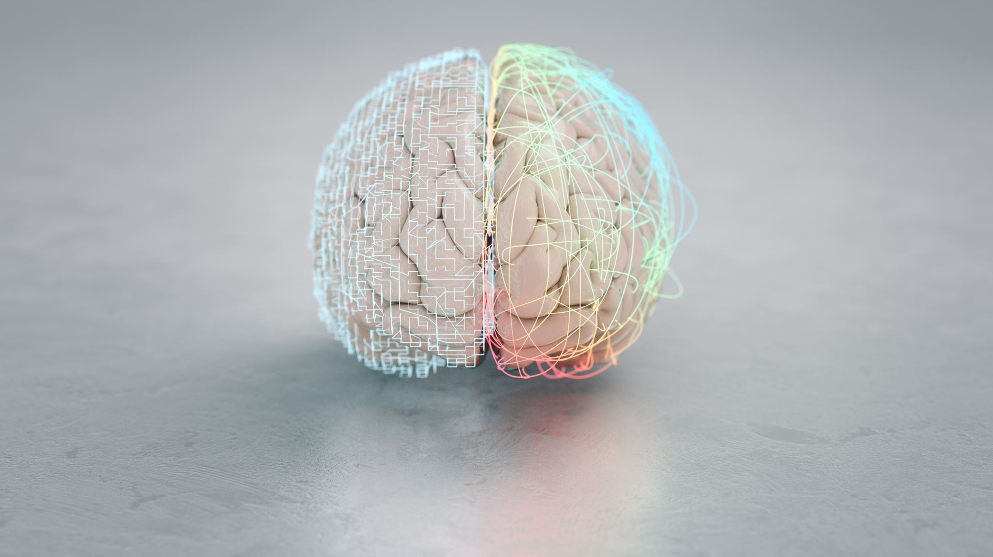
Brain Tumor Detection Using Deep Learning Techniques

Slide 3


Abstract: Brain tumors are serious and devastating diseases, which results in lower life expectancy or death. Accurate diagnosis is very important to extend the lives of the affected individuals. Manually identifying and analyzing the large number of MRI pictures is tedious, time-consuming and are prone to errors. Deep learning approaches have recently been popular to develop the capable systems for accurately diagnosing the tumors using magnetic resonance images in no time. Magnetic Resonances Imaging (MRI) is a type of scanning method that uses strong magnetic fields and radio waves to produce detailed images of the inner body.

Slide 4
Deep learning uses Convolutional Neural Network(CNN) for classifying brain cancers. The paper presents the implementation of diagnosing Brain tumor using CNN and compares the results with 16 layer VGG deep Neural network. The CNN models exhibits high accuracy and those can be seen using performance parameters like Accuracy, sensitivity, specificity. The accuracy using CNN model is expected to be 99%

Slide 5

Literature Review:
Many papers related to Brain tumor detection using machine learning and Deep learning techniques are studied and 15 reference papers are studied in detail and below mentioned is the brief summary of each paper. Image segmentation and classification is one of the major tasks in machine learning and it is widespread in clinical diagnosis also. Several machine and deep learning algorithms have been proposed for detecting brain tumors from magnetic resonance and CT images. Several findings confirm the importance of MRI and image processing tools to identify brain tumors.
For improving brain tumor classification from magnetic resonance images spectrum angle-dependent feature extraction and Spectral Clustering Independent Component Analysis (SCICA)is used. The magnetic resonance images are firstly divided into clusters depending on spectral distance. Then, Independent Component Analysis (ICA) is applied on the clustered data.

Slide 6
A Support Vector Machine (SVM) is used for the classification process. Rating was done using T1 weighted, T2 weighted, and proton density fluid inversion recovery images. To determine the stability and effectiveness of SC-ICA-based classification, a comparison with ICA-based SVM and other conventional classifiers was performed. For a recurrent lesion, ICA-based SVM analysis achieves 98% for accuracy. Hemanth et al.[8] introduced a CNN-based automated segmentation approach. This approach comprises pre-processing, average filtering, segmentation, feature extraction, and a Neural Network (NN) for classification. An accuracy of 91% has been attained. Mallick et al.[9] suggested an image compression strategy based on a Deep Wavelet Auto-encoder (DWA). A Deep Neural Network (DNN) is employed in the classification phase. An accuracy of 96% has been acquired.

Slide 7
We will use some data Preprocessing technique which is required for our model here are some data preprocessing technique which is relevant towards research papers:
Preprocessing involves noise reduction and contrast enhancement. [2]
Morphological operations are used to remove the skull from the images. [2]
The process of Image pre-processing involves data cleaning, data transformation, data integration, data resizing, data reduction, etc. [3]
The dataset images [13] of MRI were resized to fit pre-trained models. The dataset was applied to models, and the last layers were selected to deduce features. [13]
The preprocessed images are sharper and brighter with more detectable details than the original images.[14]
Preprocessing eliminates unnecessary data, smoothens noisy data, detects and eliminates outliers, rectifies data inconsistencies, and performs normalization and aggregation. [3]
Features are chosen using Genetic Algorithms (GAs). [8]
LDA(Linear Discriminant Analysis) is used as a preprocessing step in machine learning model classification. It aims at projecting features from a higher-dimensional space to a lower-dimensional space to avoid the curse of dimensionality and reduce computational costs. [11]

Slide 8
Methodology: In methodology, we will use CNN and KNN model in which we have already train and test dataset given by professor below are some methodology points which is extracted from research papers.
The paper [2] introduces three different deep learning models for brain tumor classification: Transfer-learning-based models, a CNN model named BRAIN-TUMOR-net, and a model trained from scratch. [2]
The BRAIN-TUMOR-net achieves the highest accuracy among the other models as the dataset size increases. [2]
The research proposes an automatic segmentation method based on CNN by determining small 3 x 3 kernels. [3]
CNN (Convolutional Neural Network) or ConvNet is a deep machine learning algorithm used to examine the Image [3]
The paper discusses the use of KNN (k-Nearest Neighbors) and SVM (Support Vector Machines) as classifiers. [11]
Deep learning models used include GoogleNet, NasNet-Mobile, and Shuffle-Net to extract significant features from images.[11]
The paper discusses the use of KNN (k-Nearest Neighbors) and SVM (Support Vector Machines) as classifiers.[13]
Deep learning models used include GoogleNet, NasNet-Mobile, and Shuffle-Net to extract significant features from images.[13]

Slide 9
CNN Model
convolutional neural networks (CNNs) are an effective technique for tumor identification. This method includes analyzing medical pictures which we will use MRI scans, and determining whether or not cancers are present by using specific neural network topologies. A dataset of medical photos is first gathered and labeled which is given by professor we are using dataset 2 which contain train and test data, and then preprocessing actions like scaling and normalization are performed. Next, the architecture of the CNN is created, which typically consists of fully connected, pooling, and convolutional layers. Through optimization with a loss function, the network gains the ability to identify patterns and characteristics linked to tumors during training. Metrics like accuracy and precision are used to evaluate the model's performance on a different test dataset. Adjustments and fine-tuning can be made as required to increase precision.

Slide 10
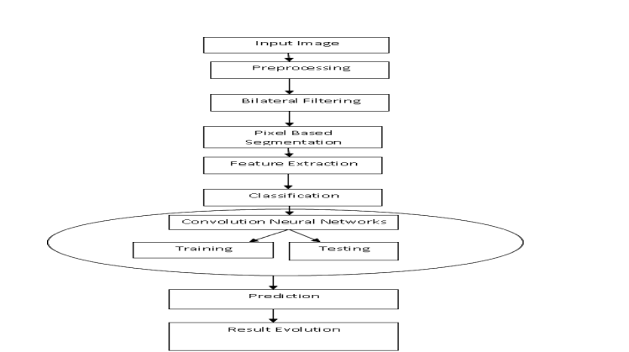
Proposed methodology for our project [3]

Slide 11
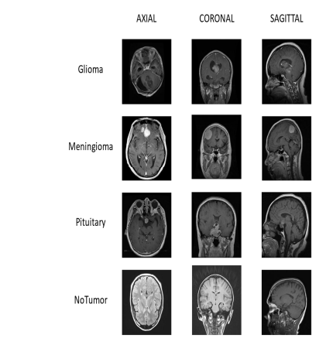
Dataset Classified as below tumor images

Slide 12
Alternative method
Several research paper discussed about another alternate way which is deep tumor net I found this mostly every paper in which they consider for a better accuracy and effective way of using in contrast on their paper which is deep learning architecture called DeepTumorNet which is built on GoogleNet. the last five levels of the GoogleNet are removed, and fifteen new layers are added. Moreover, the feature map employs a leaky ReLU activation function to improve the expressiveness of the model. These models can help automate and improve the efficiency of the diagnostic process, potentially leading to earlier detection and better patient outcomes.

Slide 13
References Papers Used:
1.Brain Tumour Detection Using Deep Learning, Avigyan Sinha @, Aneesh R P $, Malavika Suresh $, Nitha Mohan R*, Abinaya D*, Ashwin G Singer*
2.Efficient framework for brain tumor detection using different deep learning techniques, Fatma Taher1, Mohamed R. Shoaib2, Heba M. Emara2*, Khaled M. Abdelwahab2, Fathi E. Abd El-Samie2,3 and Mohammad T. Howell
3.DESIGN AND IMPLEMENTING BRAIN TUMOR DETECTION USING MACHINE LEARNING APPROACH, G.Hemanth1, M.Janardhan2,L.Sujihelen3
4.Brain Tumor Detection Using Convolutional Neural Network, Tonmoy Hossain1*, Fairuz Shadmani Shishir2@ , Mohsena Ashraf3#, MD Abdullah Al Nasim4&, Faisal Muhammad Shah5$
5.Classificatin of Brain Tumors by Machine Learning Algorithms, Gokalp Cinarer, Bulent Gursel Emiroglu
6.Brain Tumor Detection and Classification Using Intelligence Techniques: An Overview, SHUBHANGI SOLANKI 1, UDAY PRATAP SINGH 2, (Member, IEEE), SIDDHARTH SINGH CHOUHAN 3, AND SANJEEV JAIN4, (Member, IEEE)
7.Current Trends on Deep Learning Models for Brain Tumor Segmentation and Detection – A Review, S.Somasundaram, R.Gobinath
8.BRAIN TUMOR DETECTION USING DEEP LEARNING MODELS, Sneha Grampurohit, Venkamma Shalavadi, Vaishnavi R. Dhotargavi
9.A New Model for Brain Tumor Detection Using Ensemble Transfer Learning and Quantum Variational Classifier, Javeria Amin ,1 Muhammad Almas Anjum ,2 Muhammad Sharif ,3 Saima Jabeen ,4 Seifedine Kadry ,5 and Pablo Moreno Ger 6
10.Machine and Deep Learning Approaches For Brain Tumor Identification: Technologies, Applications, and Future Directions, Vikram verma, tajinder kumar Saini
11.Brain Tumor Detection and Classification Using Deep Learning and Sine-Cosine Fitness Grey Wolf Optimization, Hanaa ZainEldin 1, Samah A. Gamel 1, El-Sayed M. El-Kenawy 2,* , Amal H. Alharbi 3, Doaa Sami Khafaga 3,*,Abdelhameed Ibrahim 1,* and Fatma M. Talaat 4
12.Brain Tumor Detection Based on Deep Learning Approaches and Magnetic Resonance Imaging, Akmalbek Bobomirzaevich Abdusalomov * , Mukhriddin Mukhiddinov and Taeg Keun Whangbo *
13.Classification of Brain Tumors using MRI images based on Convolutional Neural Network and Supervised Machine Learning Algorithms, Saif Al-jumaili, Adil Deniz Duru
14.An efficient deep learning model to categorize brain tumor using reconstruction and fine-tuning, Md. Alamin Talukder a, Md. Manowarul Islam a,∗, Md. Ashraf Uddin b, Arnisha Akhter a, Md. Alamgir Jalil Pramanik c, Sunil Aryal b, Muhammad Ali Abdulllah Almoyad d, Khondokar Fida Hasan e, Mohammad Ali Moni f,∗
15.Convolutional Neural Network based Brain Tumor Detection, Shraddha S. More1, Mansi Ashok Mange2, Mitheel Sandip Sankhe3, Shwethali Santosh Sahu4

Slide 14
Brain Tumour Detection Using Deep Learning by Avigyan Sinha @, Aneesh R P $, Malavika Suresh $, Nitha Mohan R*, Abinaya D*, Ashwin G Singerji* The proposed system for brain tumor detection uses Magnetic Resonance imaging(MRI) and a dataset of normal and abnormal brain images. Gray scale conversion, noise reduction and image standardisation are the pre-processing techniques which are used to enhance the data. Image segmentation is used to separate specific regions from the background using convolutional neural networks. Automated feature extraction, combined with down-sampling and class score manipulation, forms the basis of classification. CNN architecture is used to improve the accuracy. In total the proposed system used MRI data, pre-process and apply CNN algorithm to detect brain tumors with accuracy of 98% and efficiently

Slide 15
DESIGN AND IMPLEMENTING BRAIN TUMOR DETECTION USING MACHINE LEARNING APPROACH by G.Hemanth1, M.Janardhan2,L.Sujihelen3
The study suggests a thorough method for analyzing MRI data for brain tumors. The work introduces non-local noise reduction techniques as well as local smoothing techniques to address the crucial problem of noise in MRI pictures. In order to remove extraneous data and improve image quality, pre-processing of photos includes data cleaning, transformation, integration, resizing, reduction are used. For brain tumor segmentation, it makes use of convolution neural networks (CNNs), concentrating on tiny 3x3 kernels for a detailed architecture that avoids overfitting. Intensity normalization, an unusual step in CNN-based segmentation, is also included in the study. The study uses parameters like sensitivity, specificity, accuracy, and more, to assess how well the suggested technique works. Overall, the study highlights how important CNN's and picture pre-processing are to improve the quality of MRI scans for accurate detection of brain tumor which is very crucial task in medical imaging.

Slide 16
Efficient framework for brain tumor detection using different deep learning techniques - Fatma Taher1, Mohamed R. Shoaib2, Heba M. Emara2*, Khaled M. Abdelwahab2, Fathi E. Abd El-Samie2,3 and Mohammad T. Haweel4 ​ ​ The system for detecting brain tumors using magnetic resonance imaging (MRI) and deep learning approaches is presented in this paper. It investigates transfer learning using be spoke CNN named BRAIN-TUMOR-net that was built from scratch as well as pre-trained models like ResNet and Inception. For evaluation, three different MRI datasets were employed. The suggested model achieves good accuracy, sensitivity, specificity, precision, and MCC, outperforming other pre-trained models. To guarantee reliable categorization, the research uses k-fold cross-validation. There is also discussion of various segmentation methods. All things considered, the study presents a viable method for precisely identifying brain tumors in MRI images, solving a significant medical issue.

Slide 17
Brain Tumor Detection Using Convolutional Neural Network - Tonmoy Hossain1*, Fairuz Shadmani Shishir2@ , Mohsena Ashraf3# MD Abdullah Al Nasim4&, Faisal Muhammad Shah5$
Two separate models comprise the suggested methodology for brain tumor segmentation and detection. Fuzzy C-Means (FCM) segmentation is followed by classic machine learning methods in the first model. The process consists of seven steps: feature extraction, tumor contouring, morphological operations, FCM segmentation, filtering, skull stripping, and classification using conventional classifiers. The first phases include segmenting the brain and tumor, removing non-brain areas, and improving picture quality. After that, the model extracts features and uses conventional classifiers to identify tumors with an accuracy of 92.42%, including K-Nearest Neighbor, Logistic Regression, Multilayer Perceptron, Naïve Bayes, Random Forest, and Support Vector Machine. On the other hand, the second model uses five-layer Convolutional Neural Networks (CNN) to detect tumors from 2D brain MRI data. CNN provides enhanced precision using a combined model utilizing convolutional and Max-pooling layers. Following preprocessing and feature extraction, the model achieves a remarkable 97.87% accuracy. The suggested methodology shows promising results in both brain tumor segmentation and detection by utilizing both conventional and deep learning techniques.

Slide 18
Classificatin of Brain Tumors by Machine Learning Algorithms by Gokalp Cinarer, Bulent Gursel Emiroglu
This study concentrated on utilizing machine learning techniques to classify MR brain pictures associated with various aspects of brain tumors. Four classification methods were evaluated by the authors: KNN, SVM, LDA, and RF. They made use of the Rembrandt dataset, which has 30 distinct features and 99 MRI pictures of patients. With an accuracy rate of 90%, SVM beat the other algorithms, according to the data, whereas KNN, LDA, and RF only managed accuracy rates of 87%, 83%, and 83%, respectively. In comparison to the other classifiers, SVM also demonstrated greater F1 score, sensitivity, and precision. The work demonstrates how machine learning, and specifically the SVM method, may be used to effectively classify images of brain tumors. These results advance the crucial field of early and precise brain tumor diagnosis.

Slide 19
Brain Tumor Detection and Classification Using Intelligence Techniques: An Overview
SHUBHANGI SOLANKI 1, UDAY PRATAP SINGH 2 ,SIDDHARTH SINGH CHOUHAN 3, AND SANJEEV JAIN4
The essential issue of identifying and categorizing brain tumors, which can be fatal if untreated, is the subject of the study described in this paper. The study examines the difficulties in segmenting and categorizing brain tumors, highlighting the complexity brought on by differences in tumor sizes, locations, and characteristics. Magnetic resonance imaging (MRI) is a crucial tool for locating tumors since it uses a variety of approaches.
The study suggests various methods for identifying and categorizing brain tumors using computational intelligence and statistical image processing techniques. The report also offers a thorough review of the pertinent literature on the capacities of MRI in detecting brain tumors. The study contrasts machine learning (ML), deep learning (DL), and transfer learning (TL) methods for classifying tumors. Convolutional neural networks (CNNs), one type of deep learning model, are gaining popularity due to their efficiency in classifying brain tumors. By using these models, researchers may automatically extract characteristics from MRI scans without using manually created features. The paper discusses the pros and drawbacks of deep learning. The study also emphasizes the significance of precise datasets, data augmentation, feature extraction, and classification methods in the study of brain tumors. The research discusses the important contribution of attention-based mechanisms and 3D models in enhancing tumor identification precision. With a focus on both machine learning and deep learning methods, the study concludes by offering insightful information on the developing field of brain tumor detection and classification and outlining probable future research routes in this crucial area of medical imaging

Slide 20
Current Trends on Deep Learning Models for Brain Tumor Segmentation and Detection – A Review
S.Somasundaram ,R.Gobinath
The crucial need for precise brain tumor segmentation in the medical field is the main topic of this research study, especially in the context of magnetic resonance imaging (MRI). While deep neural networks and machine learning have been successful in segmenting 2D pictures, there are still difficulties in segmenting important organs from 3D MR data. In order to achieve more thorough segmentation, the study stresses the use of 3D-based convolutional neural networks (CNNs), artificial neural networks (ANN), support vector machines (SVM), and multi-class support vector machines (MCSVM).The main steps of this procedure are described in the study, including setting up clinical imaging, pre-processing images, segmenting images, extracting features, and classifying the results. It emphasizes the crucial part that pre-processing plays in achieving correct classification and overcoming the challenges brought on by the variety of tumor features. CNNs, one of the newest advances in deep learning models, are investigated as effective methods for processing MRI images of brain tumors. The study also examines how MCSVM improves the accuracy of tumor classification, particularly when faced with the difficulties of various tumor morphologies and hazy boundaries.In order to increase the precision of brain tumor classification, artificial neural networks (ANN) and hybrid models that combine ANN with genetic algorithms (GA) are proposed as useful methods. In-depth summaries of various filters, architectures, training approaches, and their relative merits and shortcomings in diverse investigations are provided in the paper.
In conclusion, this study emphasizes the vital value of accurate brain tumor segmentation and emphasizes the potential of deep learning models and SVMs for reaching this objective.

Slide 21
BRAIN TUMOR DETECTION USING DEEP LEARNING MODELS by Sneha Grampurohit ,Venkamma Shalavadi , Vaishnavi R. Dhotargavi
The goal of this work is to develop a brain tumor detection model based on MRI scans of 253 patients, 155 of whom had tumors and 98 of whom did not. Data augmentation, grayscale conversion, noise reduction, and picture scaling are some of the processes that make up data preprocessing. Two different algorithms are used to meet the tumor identification task: the VGG-16 architecture and the Convolutional Neural Network (CNN). Convolutional layers, which extract features and improve classification, as well as nonlinear activation functions and pooling layers are advantageous to CNN. As an effective feature extractor, VGG-16, on the other hand, uses a deep neural network architecture with 3x3 convolutional filters. The results show that while VGG-16 uses more computer power, it produces results with higher precision. The promise of deep learning in medical picture processing is highlighted by this study, especially in light of the expanding amount of medical data. As technology advances, such models could significantly aid in the early and accurate diagnosis of medical conditions, improving patient care and outcomes. Accuracy using VGG-16 : 97.1%
Accuracy using CNN : 93.3%

Slide 22
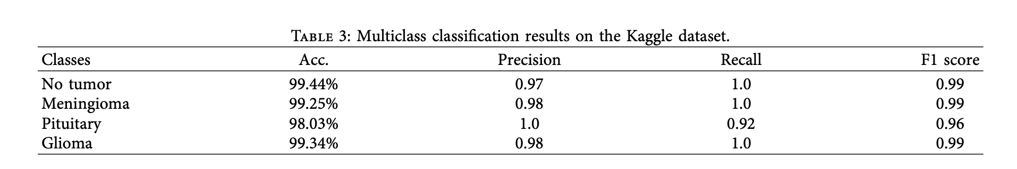
A New Model for Brain Tumor Detection Using Ensemble Transfer Learning and Quantum Variational Classifier
Javeria Amin ,1 Muhammad Almas Anjum ,2 Muhammad Sharif ,3 Saima Jabeen ,4 Seifedine Kadry ,5 and Pablo Moreno Ger 6
This paper presents a three-phase brain tumor analysis protocol. In Phase-I, a pretrained Inceptionv3 model is used to extract features, and a quantum learning mechanism is used to classify tumors according to a score vector. A SegNet model is utilized in Phase-II to partition tumor lesions semantically. Figure 1 shows the processes of the suggested model. The 315 layers of Inceptionv3 are used to extract features, while the softmax layer is used to conduct classification. Tumor categorization is achieved by feeding the softmax layer's score vectors into a quantum model. In order to get around the limitations of quantum computing, this work presents a data reuploading classifier for brain tumor classification and uses variational quantum algorithms. For semantic segmentation, the 59-layer SegNet model is introduced. The subnetworks of encoders and decoders in SegNet handle downsampling and upsampling, respectively, with depths determined by the input resolution.

Slide 23
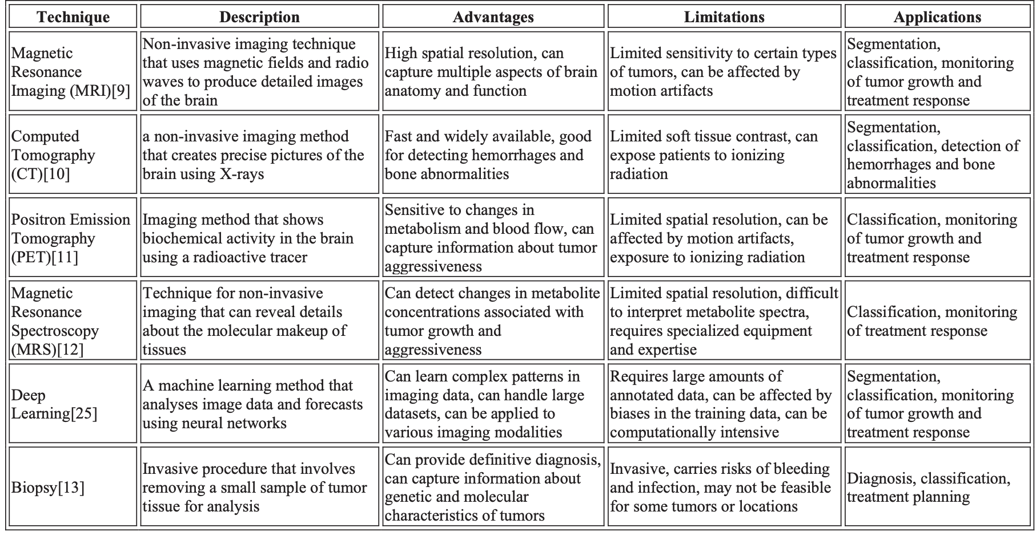
Machine and Deep Learning Approaches For Brain Tumor Identification: Technologies, Applications, and Future Directions – Vikram verma, Tajinder kumar Saini
This study's methodology addresses the issue of sparsely annotated data by utilizing deep learning techniques to enhance brain tumor identification. The main goals are to investigate the use of deep learning for brain tumor detection using medical imaging data from PET, CT, and MRI scans; to develop precise algorithms to differentiate benign from malignant tumors; to mitigate data limitations by utilizing transfer learning and data augmentation; and to assess the effectiveness of deep learning models against human experts and conventional methods. Key research problems like the most effective deep learning architectures for brain tumor identification, how well they perform in comparison to accepted medical techniques, how to overcome obstacles in clinical settings, and how to handle the social and legal difficulties surrounding these are all addressed in this study. Various datasets and machine learning phases, from data collection to deployment, are described as part of the brain tumor identification process.

Slide 24
Brain Tumor Detection and Classification Using Deep Learning and Sine-Cosine Fitness Grey Wolf Optimization
Hanaa ZainEldin 1, Samah A. Gamel 1, El-Sayed M. El-Kenawy 2,* , Amal H. Alharbi 3, Doaa Sami Khafaga 3,*,
Abdelhameed Ibrahim 1,* and Fatma M. Talaat 4
This section presents state-of-the-art approaches for classifying brain tumors that fall into three categories: hybrid, machine learning, and deep learning. Using Vision Transformers, transfer learning for enhanced performance, and CNN models with excellent accuracy are a few notable deep learning techniques. Support vector machines, one type of machine learning technology, improve classification accuracy. Hybrid approaches exhibit improved overall accuracy by combining deep and shallow features.
This section presents the Brain Tumor Classification Model (BCM-CNN), which uses a Convolutional Neural Network architecture to diagnose brain cancers. The general structure of the model, as shown in Figure 1, consists of training with an Inception-ResnetV2 model and hyperparameter optimization. The BCM-CNN uses popular pre-trained models like Inception-ResnetV2 to increase the efficiency of its binary result (0: Normal, 1: Tumor).

Slide 25
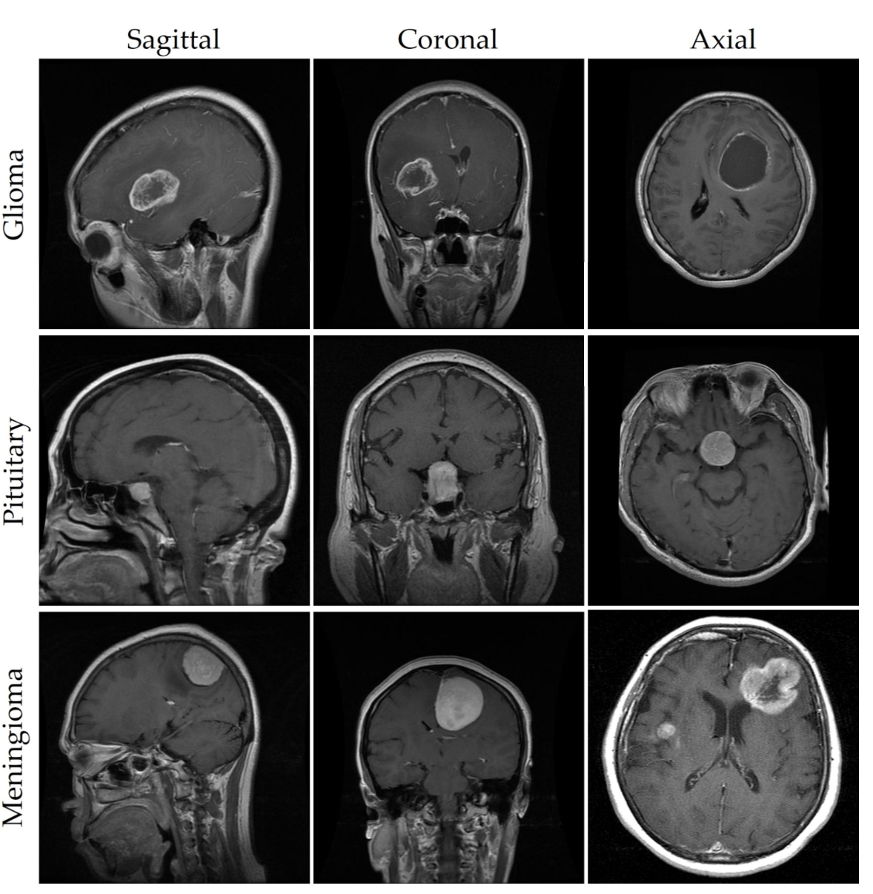
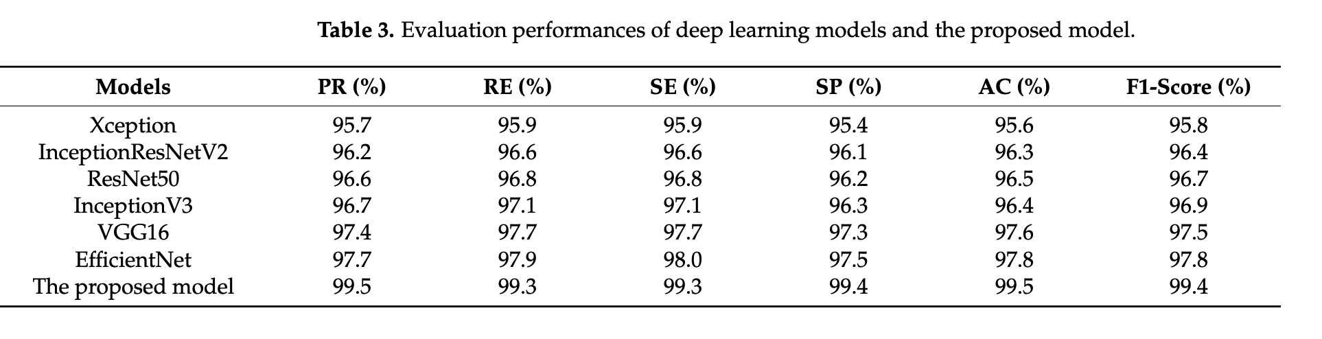
Brain Tumor Detection Based on Deep Learning Approaches and Magnetic Resonance Imaging Akmalbek Bobomirzaevich Abdusalomov * , Mukhriddin Mukhiddinov and Taeg Keun Whangbo *
For effective tumor diagnosis in MRI images, these techniques frequently make use of convolutional neural networks (CNNs) and complex designs like YOLOv7. Preprocessing and augmenting data are also critical to improving the quantity and quality of training data, which is necessary to train dependable models. photos of meningioma, pituitary, and glioma tumors as well as a class of photos with "no tumor" are included in the dataset; these have been meticulously categorized and curated by medical professionals to assure correctness. Techniques for data augmentation are used to raise the diversity of the training samples, ultimately improving the model's generalizability and predictive power Utilizing the gathered datasets proposed model achieved a notable pre- diction accuracy of 99.5%.

Slide 26
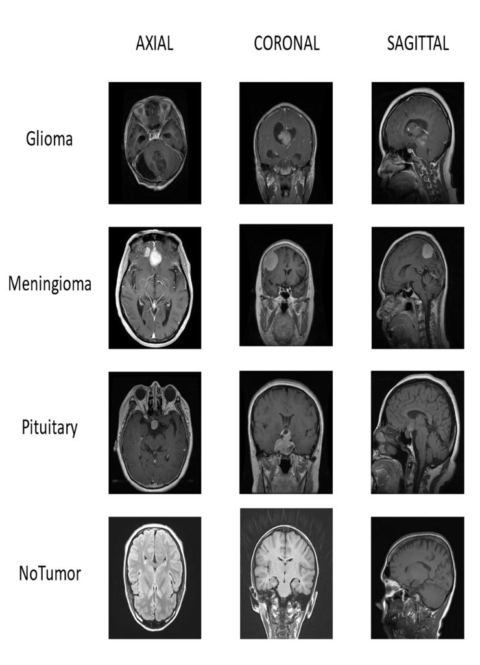
Classification of Brain Tumors using MRI images based on Convolutional Neural Network and Supervised Machine Learning Algorithms
Objective of the Research Paper:
Develop a method for classifying brain tumors using MRI images.
Improve the accuracy and efficiency of brain tumor classification.
Utilize AI techniques, including CNN and supervised machine learning algorithms.
Propose a hybrid method combining deep learning CNN models with supervised classifiers.
Focus on four brain tumor classes: glioma, meningioma, pituitary, and no tumor.
Extract features from MRI images using CNN models.
Achieve high performance in accuracy, precision, recall, and F1-Score.
Compare results with other state-of-the-art papers to demonstrate superiority.

Slide 27
Classification of Brain Tumors using MRI images based on Convolutional Neural Network and Supervised Machine Learning Algorithms
About the Research Paper Dataset:
Dataset includes 6,321 MRI images.
Categorized into four classes: glioma, meningioma, pituitary, and no tumor.
Obtained from Kaggle, FigShare, SARTAJ dataset, and Br35H.
Used for analysis and model training.
Data Preprocessing Insights:
Augmentation Techniques: Image rotation, sharing, scaling, and reflection.
Enhance dataset diversity and reduce overfitting.
Resizing Images: Uniform dimensions (224x224x3 pixels) for optimal deep learning model performance.
Grayscale Conversion: Simplify data and reduce computational complexity.
Standardize the dataset for deep learning and ML models.

Slide 28
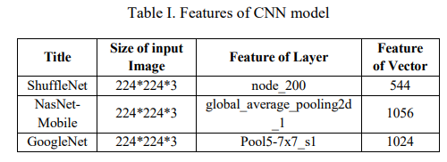
Classification of Brain Tumors using MRI images based on Convolutional Neural Network and Supervised Machine Learning Algorithms
Machine Learning/Deep Learning Models: Deep Learning Models:
GoogleNet: 22 learning layers, used for feature extraction from MRI images.
NasNet-Mobile: CNN model for feature extraction.
ShuffleNet: CNN model for feature extraction.
Machine Learning Classifiers:
k-Nearest Neighbor (KNN)
Support Vector Machines (SVM)
Linear Discriminant Analysis (LDA)
Hybrid approach combines deep learning and ML for classification.

Slide 29
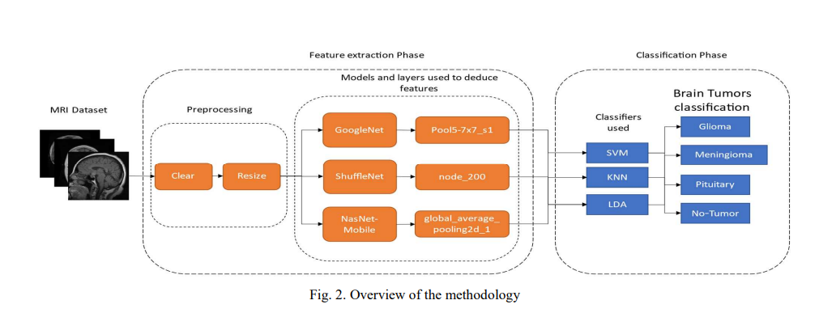
Classification of Brain Tumors using MRI images based on Convolutional Neural Network and Supervised Machine Learning Algorithms
Experimental Details:
Dataset includes 6,321 MRI scans with four brain tumor types.
Data augmentation techniques applied for model improvement.
MRI images resized to a uniform dimension of 224x224x3 pixels.
Deep learning models (GoogleNet, NasNet-Mobile, ShuffleNet) used for feature extraction.
Extracted features fed into machine learning classifiers (KNN, SVM, LDA).
Performance evaluated using accuracy, precision, recall, and F1-score.
Cross-validation with k=5 employed to mitigate overfitting.
ShuffleNet with SVM achieved the highest accuracy of 98.40%.

Slide 30
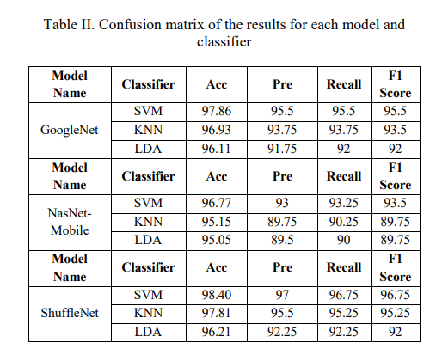
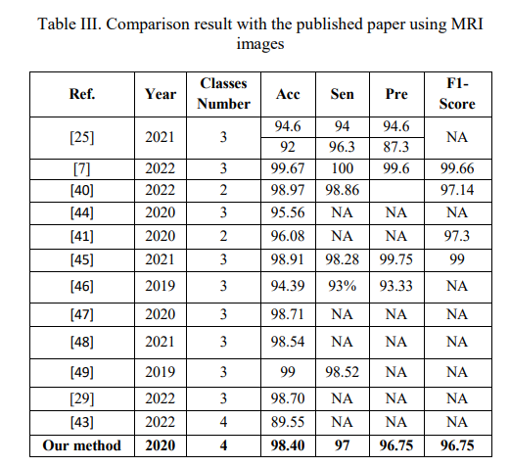
Classification of Brain Tumors using MRI images based on Convolutional Neural Network and Supervised Machine Learning Algorithms
Results:
ShuffleNet with SVM achieved the highest accuracy (98.40%).
Precision: 97%, Recall: 96.75%, F1-Score: 96.75%.
Outperformed other state-of-the-art papers in accuracy, precision, recall, and F1-score.
Compared favorably to different deep learning architectures and classic methods like SVM.
Presented results in confusion matrices, showing the effectiveness of combining deep learning and machine learning models.

Slide 31
Classification of Brain Tumors using MRI images based on Convolutional Neural Network and Supervised Machine Learning Algorithms
Conclusion:
This paper proposes a hybrid deep learning and machine learning approach for brain tumor classification from MRI images.
As preprocessing, techniques like augmentation, resizing and grayscale conversion are applied.
Three CNN models - GoogLeNet, ShuffleNet and NasNet Mobile - are used for feature extraction from the MRI images.
The extracted features are fed into 3 conventional ML classifiers - SVM, KNN and LDA.
ShuffleNet + SVM achieves the best performance with 98.4% accuracy, 97% precision, 96.75% recall and F1-score.
The lightweight ShuffleNet architecture extracts more discriminative features compared to GoogLeNet and NasNet Mobile.
The results are compared to recent papers, and the proposed hybrid approach provides superior tumor classification accuracy.
The authors of the research report "Classification of Brain Tumors using MRI images based on Convolutional Neural Network and Supervised Machine Learning Algorithms" are
Saif Al-jumaili: Affiliated with the Electrical and Computer Engineering department at Altinbas University in Istanbul, Turkey. Email: saif.aljumaili@ogr.altinbas.edu.tr, saifabdalrhman@gmail.com
Adil Deniz Duru: Affiliated with the Neuroscience and Psychology Research in Sports Lab at Marmara University in Istanbul, Turkey. Email: deniz.duru@marmara.edu.tr
Osman Nuri Ucan: Affiliated with the Electrical and Computer Engineering department at Altinbas University in Istanbul, Turkey. Email: osman.ucan@altinbas.edu.tr
Aytug Boyaci: Affiliated with the Department of Computer Engineering at Air Force Academy in Istanbul, Turkey. Email: aytugboyaci@firat.edu.tr
Dilek Goksel Duru: Affiliated with the Faculty of Science at Turkish-German University in Istanbul, Turkey. Email: dilek.goksel@tau.edu.tr

Slide 32
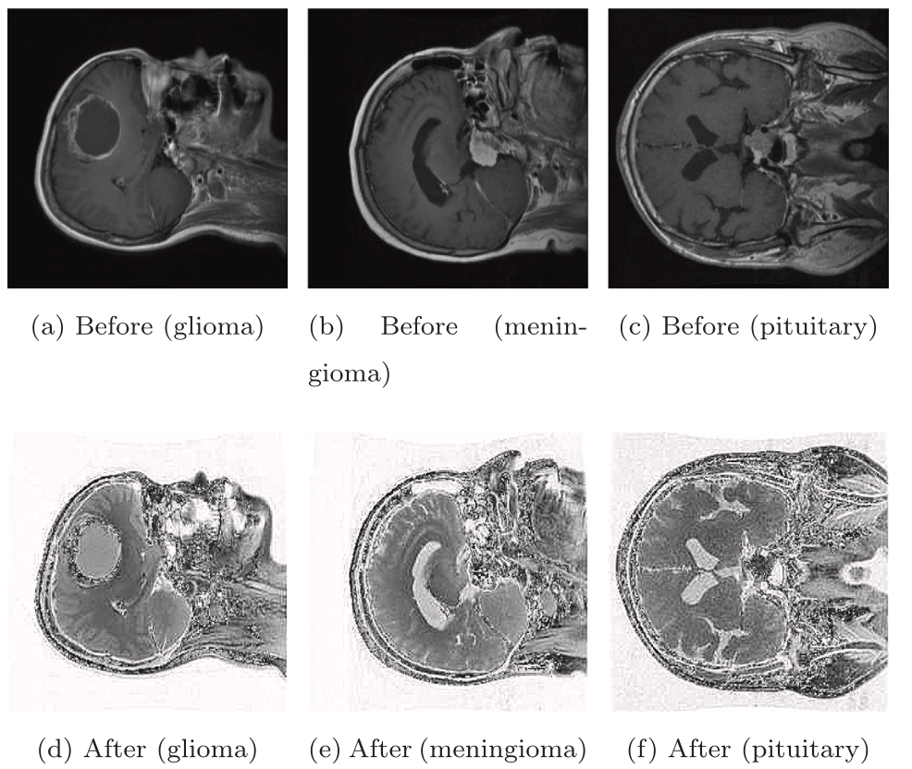
An efficient deep learning model to categorize brain tumor using reconstruction and fine-tuning by
Md. Alamin Talukder a, Md. Manowarul Islam a,∗, Md. Ashraf Uddin b, Arnisha Akhter a, Md. Alamgir Jalil Pramanik c, Sunil Aryal b, Muhammad Ali Abdulllah Almoyad d, Khondokar Fida Hasan e, Mohammad Ali Moni f,∗
The dataset for this study includes 3064 T1-weighted contrast-enhanced brain images from 233 patients with three types of tumors: meningioma (708 images), glioma (1426 images), and pituitary tumors (930 images). Each image includes labels (1 for meningioma, 2 for glioma, and 3 for pituitary tumors), patient identifiers, image information, and tumor margins. The dataset also provides binary tumor masks. Data preprocessing involves resizing the images to 256 x 256, applying sharpness filters and scaling the pixel values to fit a convolutional neural network (CNN). The dataset is divided into training, test and validation sets (80%, 10% and 10% respectively) and shuffled several times. Preprocessing significantly improves image quality, making them suitable for model input. Transfer learning architectures (Xception, ResNet50V2, InceptionResNetV2, DenseNet201) are used, complemented by techniques such as translation, rotation and contrast adjustment. Additional layers are added to improve the architecture and fine-tune for classification.
The analysis results reveal that ResNet50V2 achieved the high- est overall performance with an accuracy of 99.68%, followed by InceptionResNetV2 with an accuracy of 99.36%, DenseNet201 with an accuracy of 98.72%, and Xception with an accuracy of 98.40%. ResNet50V2 also achieved the highest precision, recall, F1-score, MCC, Kappa, and CSI among the proposed models. Overall, the analysis indicates that ResNet50V2 is the most effective transfer learning model for the given task, followed by InceptionResNetV2, DenseNet201, and Xception.

Slide 33
Convolutional Neural Network based Brain Tumor Detection by Shraddha S. More1, Mansi Ashok Mange2, Mitheel Sandip Sankhe3, Shwethali Santosh Sahu4 The proposed brain tumor detection system uses Convolutional Neural Networks (CNN) where It takes input MRI images in JPEG format and detects the presence of brain tumors. To improve accuracy, a large dataset is created using data augmentation, which produces multiple variations of the same MRI image at different angles. These added images are then analyzed using a CNN algorithm to determine the presence of a brain tumor. This approach quickly provides neurologists with detailed results. Data augmentation is critical for robust training because the original Google dataset is small, containing about 200 images. The enhancement includes transformations such as translation and style transfer to expand the dataset. Image preprocessing is another critical step to improve image quality by avoiding unnecessary distortions and highlighting important brain functions. The step mentioned in the text is to convert RGB images to grayscale.
F1 score: 89.16%
Accuracy : 87.42%

